Slide 1
Threads Synchronization

Slide 2
Multi-Threading
Motivation for Multi-Threading
  User-interface
    User can give requests while Something is running
  Optimize throughput
    When some process is stuck in some resource like I/O waiting for a response, others can use the CPU
  Multi-Processor environment
    To utilize all the processors (Like in a web server)

Slide 3
Synchronization
Access to same object from different threads concurrently can create problems.
  Read-Read Conflicts : Mostly no-problem
  Read-Write Conflicts
  Write-Write Conflicts
“synchronized” keyword in java can give exclusive access in object level
Only one thread can be found in a synchronized method or a synchronized code section of an object.

Slide 4
Synchronization
“synchronized” keyword can be used in a several places.
It locks an OBJECT for a BLOCK of code.
Whenever this thread is in that BLOCK, other threads cannot enter into any block that needs the locking (synchronization) of that same OBJECT.

Slide 5
Using “synchronize” keyword
Before any non-static method definition
    It locks this object until the end of the method block.
    class M {
    synchronized void f() {
    // It will lock this M instance
    …
    // It will unlock back this M instance
    }
    }

Slide 6
Using “synchronize” keyword
Within any block of code
    It locks the given object until the end of the block.
    …
    M m = new M() ;
    …
    synchronized( m ) {
    // It will lock the object referenced by m
    …
    // It will unlock back the object m
    }

Slide 7
Using “synchronize” keyword
Before any static method definition
    It locks this.getClass() object until the end of the method block.
    Every class definition has an instance of “Class” class associated with it. It can be reached by getClass() method of any instance. It is that specific Class instance that it locks.
    class M {
    synchronized static void f() {
    // It will lock the class M
    …
    // It will unlock back the class M
    }
    }

Slide 8
Using “synchronize” keyword
Static level synchronization within any block
    To lock static level synchronization within a block the getClass() method can be used to get the instance of Class associated with any class.
    …
    M m = new M() ;
    …
    synchronized( m.getClass() ) { // or ( M.class )
    // It will lock the class M
    …
    // It will unlock back the class M
    }

Slide 9
Synchronization
Object Level Synchronization
  class MyClass {
  synchronized void method1() { …A… }
  synchronized void method2() { …B… }
  void method3() {
  …
  synchronized(this) {
  …C…
  }
  …
  }
  }
  …
  MyClass m = new MyClass() ;
  m.method1() ; // synchronized on m
  m.method3() ; // partly synchronized on m
  synchronized(m) { …D… } // synchronized on m
Only one thread can be in one of the sections A,B,C,and D, for a single object m.

Slide 10
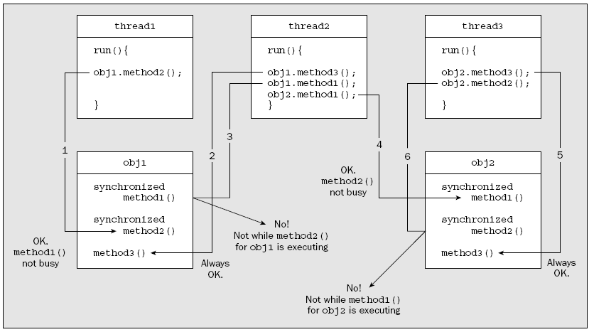

Object level Synchronization
There is a distinction between an object that has instance methods that you declared as synchronized in the class definition and the threads of execution that might use them

Slide 11
Synchronization
Class based Synchronization
  class MyClass {
  static synchronized void method3() { …A… }
  }
  …
  MyClass m1 = new MyClass();
  MyClass m2 = new MyClass() ;
  …
  synchronized(m1.getClass()) { …B… }
  …
  synchronized(m2.getClass()) { …C… }
  …
  Only one thread can be in one of the sections A,B and C

Slide 12
Multi-tasking problems
Starvation (Contention):
  When a thread fails to run in Runnable state.
  A thread cannot get CPU resource since other threads or processes are getting it.
Dormancy:
  A non-runnable thread fails to become runnable.
  When a thread stays in a wait(), while there is no other thread that makes notify() for that object.
Deadlock:
  Two or more threads block each other.
  Thread 1 locks the object a, and waits for object b.
  Thread 2 locks the object b, and waits for object a.

